Slide 1
Chapters 2 & 3
Communication, The Self, and Perception

Slide 2
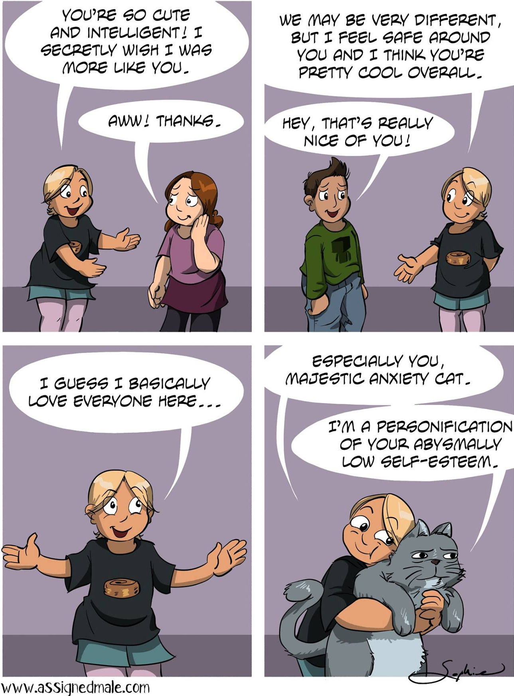
What Is the Self?
The Self: Arises in Communication with Others
Particular Others
These are the special people
in our lives!
They are also the first people to influence
our self perception
How do they influence our sense of self?
Direct Definition
Statements that directly identify our important identities and traits
Can include qualities (good, bad, smart, dumb, etc.), identities (name, nationality, religion)
Is openly and explicitly stated by the particular other, with no intended ambiguity
Reflected Appraisal
Statements or treatment that indirectly identified our important identities or traits
Can be positive or negative, intentional or unintentional
Includes the same key features as direct definition, but is done indirectly → it is a sense we get about how others view us
E.g. in the above clip: what sense of himself does Nemo get from his father’s treatment? How does he think his father views him, regardless of intentions?

Slide 3
What Is the Self?
The Self: Arises in Communication with Others
Particular Others (cont’d)
Identity Scripts
Identity scripts connect our identities to certain behaviours or practices
On the one hand, we learn values/proper behavior from watching the actions of particular others → e.g. we can learn the importance of tidiness from watching people clean the house regularly, without being explicitly told the value
On the other hand, we express ourselves to others through our actions → e.g. showing respect to others can be a reflection of personal or cultural values (we act them out as scripts for behavior)
In some cases, particular others might specifically explain appropriate behaviour to us → if we absorb it as part of our identity, it is also an identity script
Attachment Styles (see next slide)
Dr. Ainsworth
Self-Fulfilling Prophecy

Slide 4
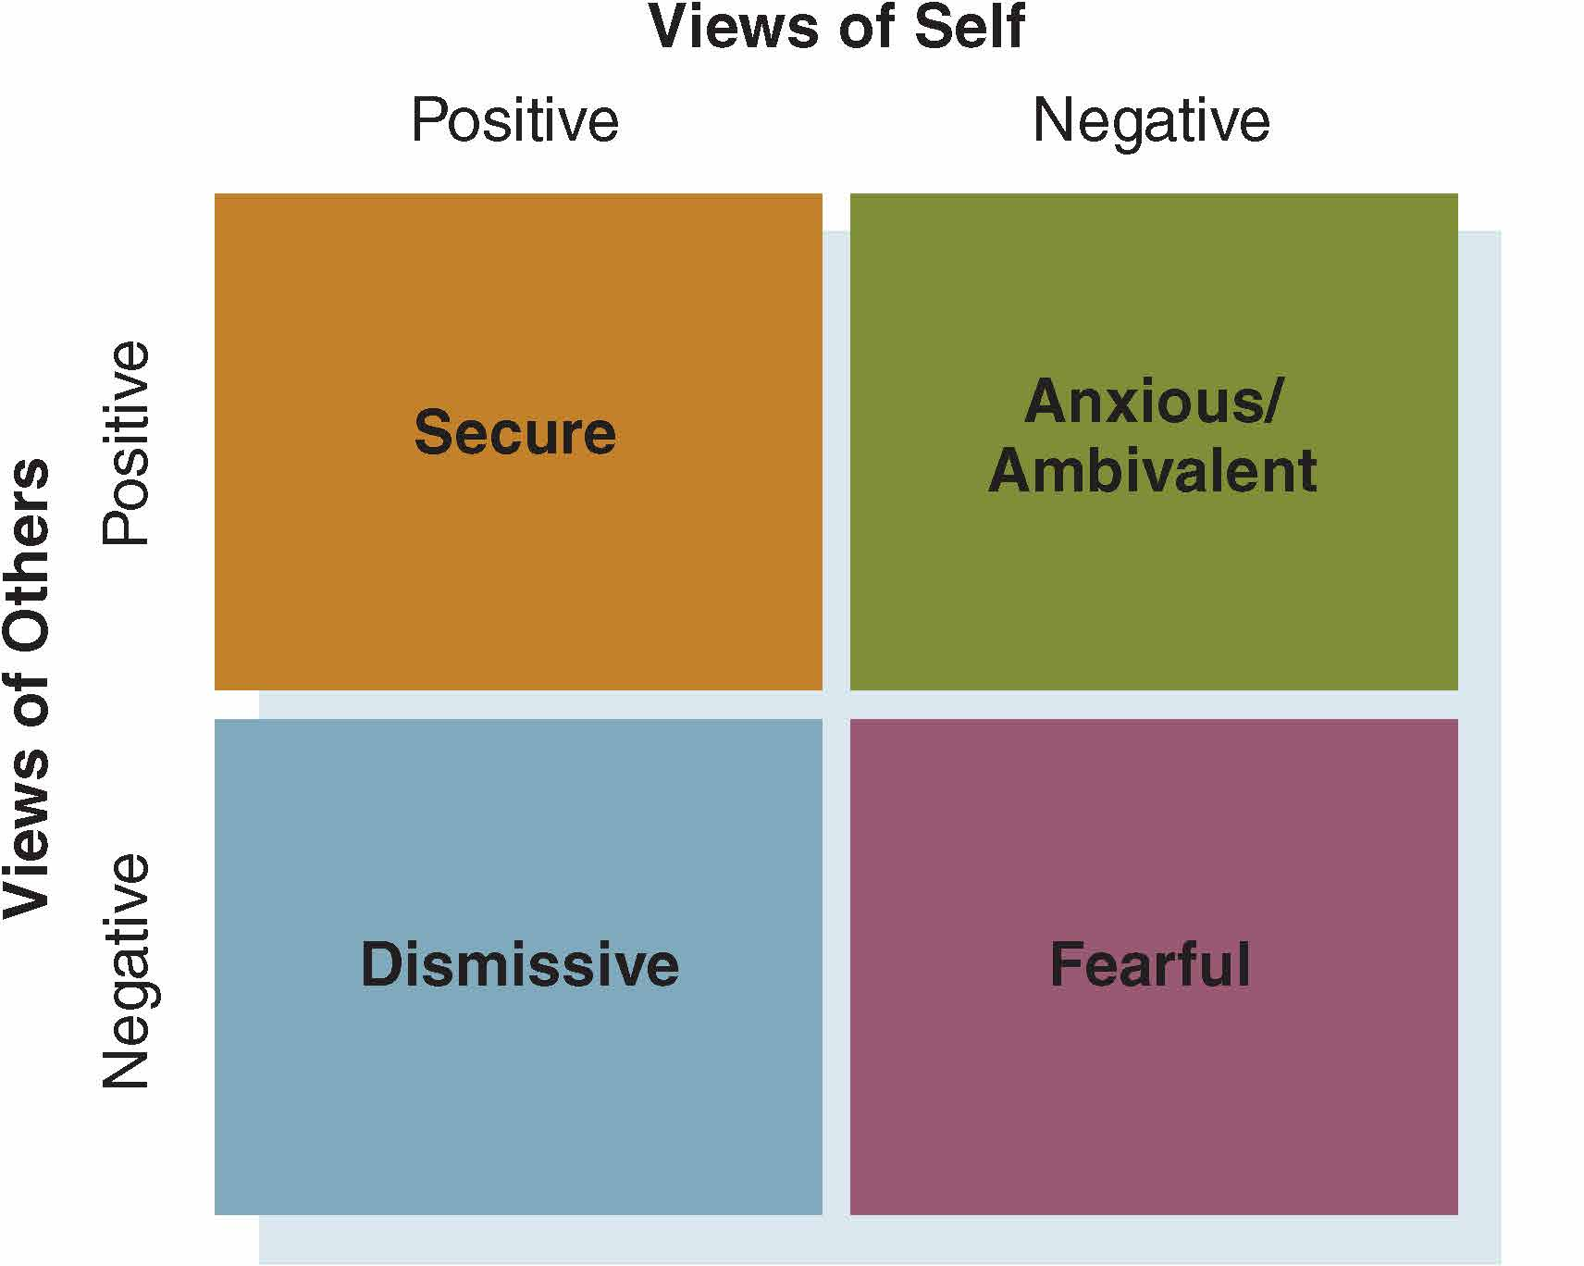
Attachment Styles

Slide 5
What is The Self?
Attachment Styles:
Secure: usually a product of loving and supportive environments → as a result of the affection shown by our particular others, we value ourselves and view others in a positive light; more likely to express affection openly and seek direct affection
Dismissive: As a result of inconsistent treatment from particular others, we get mixed messages → as a result, we view ourselves positively, but others as untrustworthy; we become dismissive of the views/opinions feelings of others
Anxious/Ambivalent: also a product of inconsistent treatment → in this case, we trust the views of others and see the treatment as a negative reflection of us; overly concerned (anxious) about pleasing others and fearful of disapproval
Fearful: product of abusive or violent upbringing → views self negatively and others as potential abusers; untrusting and very tentative to commit emotionally to relationships

Slide 6
What Is the Self?
The Self: Arises in Communication with Others
The Generalized Others
Broader social and cultural norms that influence the terms by which we identify ourselves, and set expectations for proper behaviour
Is “normative”: assumes traits and often implies value
How do they influence our sense of self?
Race and Ethnicity
Gender
Sexual Orientation
Socioeconomic Status → income, job, fashion, etc.
Social Comparison: upward and downward

Slide 7
What Is the Self?
The Self: Arises in Communication with Others
Remember:
The self is multi-demensional → assumes physical, moral, and cognitive features
The development of the self is a process → it changes based on time and context
We develop ego boundaries and a self-concept
Ego boundaries: A clear recognized separation between ourselves, others, and our environment
Self-Concept: A sense of self, our features, our abilities, and our potential

Slide 8
Perception is the active process of creating meaning by selecting, organizing, and interpreting people, objects, events, situations, and activities

Slide 9
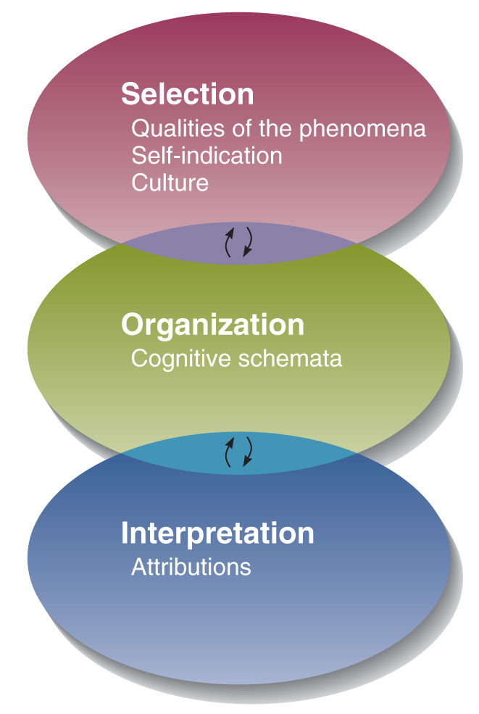
The Process of Human Perception

Slide 10
Perception
Everything we perceive through our senses (sight, feeling, sound, taste, smell) is processed through perception’s three stages
First we select the important features of the stimuli
Then we organize it so that it makes sense → we do this by applying cognitive schema (or filters) that try to fit this new thing into previous formers or preconceived ideas of what it could be
Then we interpret/explain to ourselves what it must be and determine a reasonable response to it
This process happens extremely quickly

Slide 11

Selection
What do
you see?
If you saw two faces or a vase, how did your brain manage to create that interpretation of the picture?

Slide 12
Selection
This is a process of selecting the key features of whatever you are perceiving to begin to figure out what it is
Qualities of the phenomena
Things that stand out immediately: are typically loud, bright, fast → in the above picture, your brain immediately noticed differences in colour and shape to begin interpreting the picture
Self-indication
Our personal circumstances can also dictate the selection process
Are you hungry? You might notice the smell of food, or look specifically for restaurants
Did you recently break up with someone? You might notice couples in public (making you sad), or might be drawn to attractive people more than usual
Culture can also influence our perception → different cultures have different customs or art forms that can inform what we tend to notice in a room, or a painting, or someone’s behaviour, thus influencing the perceptions process

Slide 13
Organization
Once we have selected what is important, our brain has to try to figure out what, exactly, it is that we are perceiving
It would take too long for our brain to come up with an original interpretation for every noise we hear or picture we see
Instead, it rapidly attempts to match the new stimuli to previously experienced images/forms in order to see whether it matches
These forms, or “filters” are also called “cognitive schemata” and they allow us to organize stimuli quickly

Slide 14
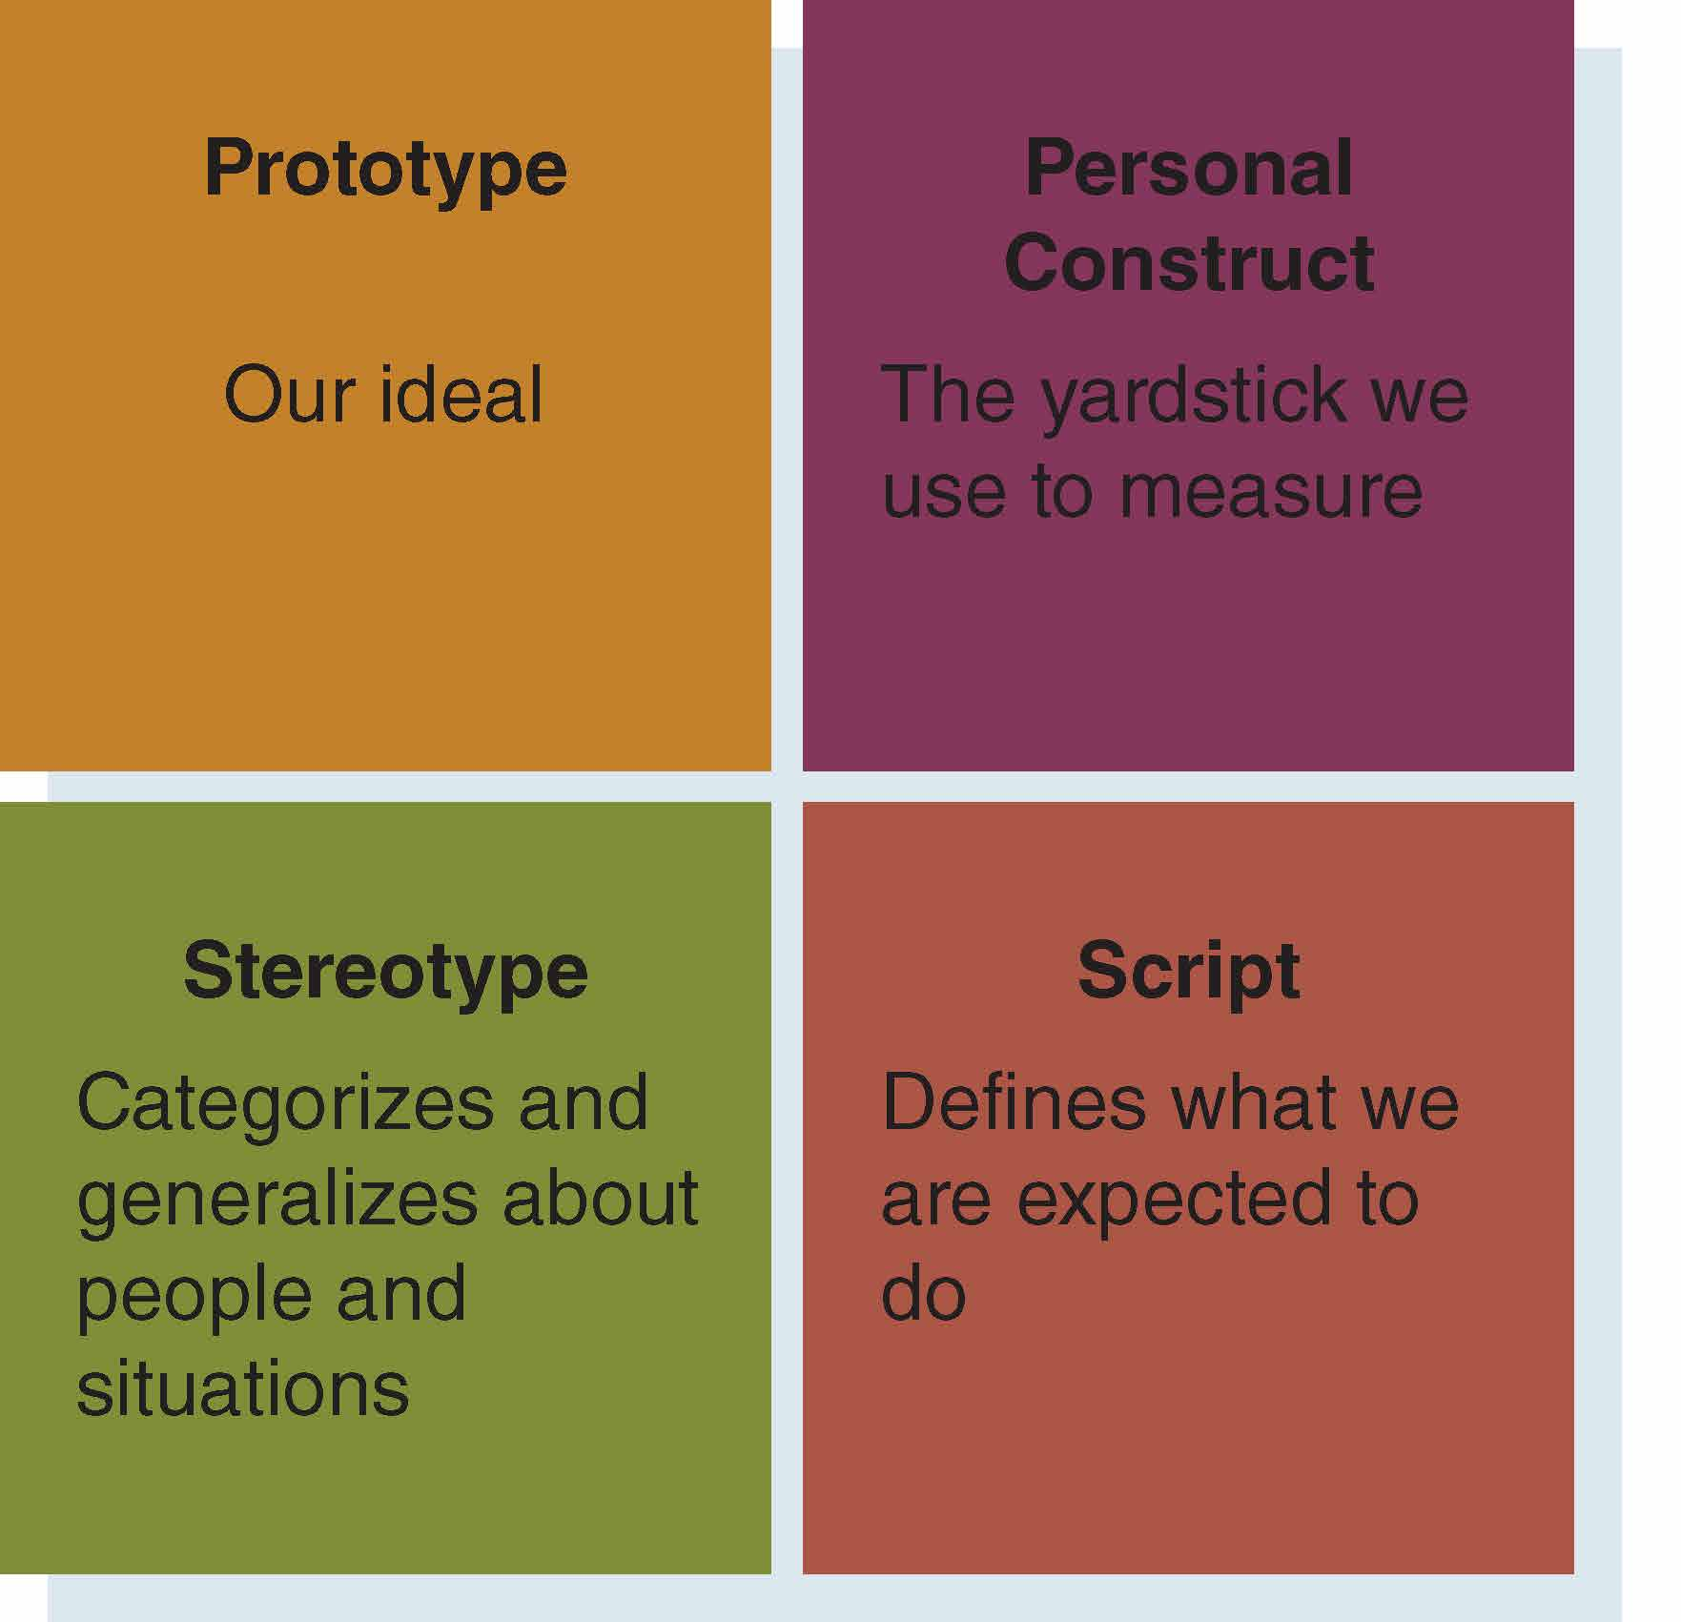
Organization
Four
Cognitive
Schemata
(How do they affect our expectations?)

Slide 15
Four Cognitive Schemata
Prototypes: An ideal of something, whether it’s a person, or an image, or a sound
Our brain tries to match the new concept to old ideals to see if it matches: e.g. when you meet someone new, you will most likely immediately compare them to your ideal of a friend – based on your existing friends – to determine whether they seem like the kind of person you could be friends with
Personal Constructs: A more detailed version of a prototype; when we experience something, our brain tries to qualitatively organize it based on a series of standards (or constructs) that might apply to it
For example, when meeting that new person, our brain will try to determine whether they are likeable based on a series of values we might have: are they intelligent/unintelligent, attractive/unattractive, funny/not funny, well-dressed/poorly dressed → where they fall in each of these constructs will help us determine their potential quality as friends

Slide 16
Four Cognitive Schemata (cont’d)
Stereotypes: Categorizes and generalizes about people and situations in order to more quickly determine their quality → Can be dangerous when we mistake an individual for a stereotype about them
For example, when determining whether we like that new person, and to determine whether they are intelligent, we might notice that they are wearing glasses and use big words, which we associate with intelligence. We might be accurate or we might not be, and if we assume all smart people have glasses, it will not be to our benefit or those we meet.
Scripts: Helps us determine situations based on expected behaviours. Our brain does not only perceive what something is, but how we are expected to interact with it quickly → often uses stereotypes
For example, a “high five”. When we see someone put their hand up in the air, we quickly stereotype the action as typical of a “high five” and determine that the most appropriate response is to reciprocate.

Slide 17
Stereotypes
Predictive generalizations about minority groups based on assumptions that all members are the same

Slide 18
Interpretation - Attribution
Attribution: an explanation for why something happened or why something is a certain way.
The process of interpretation, determining what something really is, and therefore how we should respond, depends on attribution
Our brain tells us who or what caused this event to happen, and therefore the right response
Basic example, a “high five”. If we attribute the action to the person doing it in an honest way, we will respond kindly. If we are suspicious that the person was convinced to high five us for some other reason, or that they have us confused with someone else, we will not respond the same way.
Notes:
External – others, weather, equipment, objects, time, etc.
Internal – personality, personal capability, individual factors

Slide 19
Attribution Errors
There are two common types of errors we make in attributing purpose to things
Self-Serving Bias:
We tend to see ourselves in a positive light.
We tend to minimize or ignore negative information about the self.
E.g. Of course the purpose wants to high-five me, because I am awesome!
Fundamental Attribution Error
We tend to over-estimate the degree to which others’ actions are dictated by their own choices
When others make a mistake, we are far less forgiving of them – determining the error/offense to be intentional or a reflection of their poor character – than when we do something wrong.
Notes:
External – others, weather, equipment, objects, time, etc.
Internal – personality, personal capability, individual factors

Slide 20
Influences on Perception
Physiology
Age
Culture (Standpoint)
Roles
Cognitive Abilities (Cognitive Complexity, Person-Centredness)
Self

Slide 21
Guidelines for Improving Perception and Communication
Recognize That All Perceptions Are Partial and Subjective
Avoid Mind-Reading
Check Perceptions with Others
Perception Check: 3 steps
Point out the specific words or actions of another person
Provide your interpretation of that action
Clarify whether your interpretation is accurate
Distinguish Between Facts and Inferences
Guard Against the Self-serving Bias
Guard Against the Fundamental Attribution Error
Monitor Labels

